Slide 1

Tradenxchange
A marketplace for gamers by gamers.

Slide 2
Overview
3 stakeholders
Buyers
Sellers
Admin
Activities
Listing
Marking Purchased/Sold
Texting
Explained in detail in “How it works section” after ERD

Slide 3
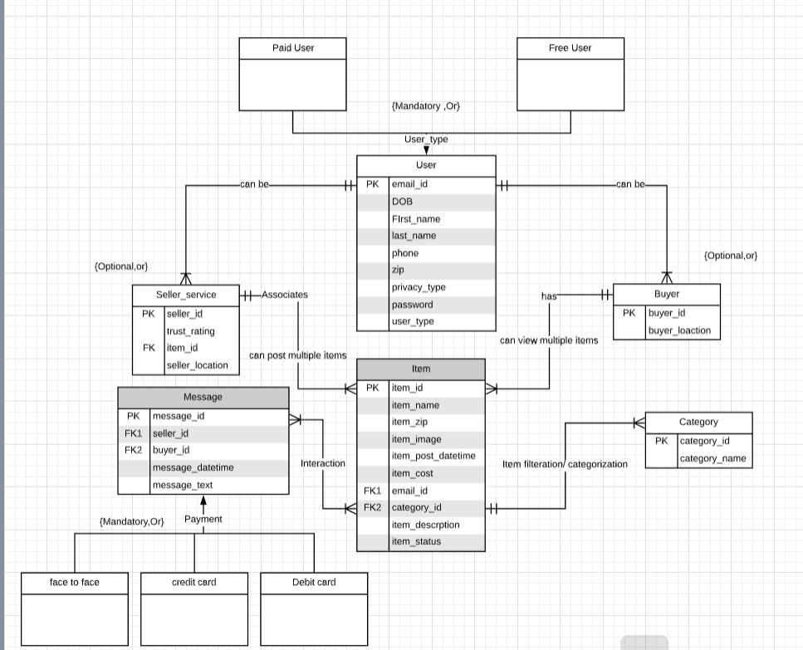
ERD

Slide 4
How it works!
● Any individual can sign up as a user
● Admin credentials will be pre-set.
● Users can be either Sellers, Buyers both buyers and sellers.
● Sellers are allowed to post an item for sale.
● Sellers are allowed to set their own price.
● Sellers are allowed to edit the price and item details at any point of time
● Buyers are allowed to browse through the categories
● Buyers are allowed to browse through the sub-categories
● Buyers are allowed to browse through the list of items
● Buyers are allowed to initiate a conversation for a particular item

Slide 5
Continued slide…
● Sellers are allowed to reply to the conversation.
● If the buyer offers a price lower than the asking price it sends a negotiation message to the seller.
● Seller has the option to reject the offer, accept the offer or propose a counter offer
● Sellers are allowed to mark the item as sold.
● Sellers are allowed to mark the buyer.
● Buyers can access and see the sold items but can’t offer for them
● Buyers can rate the sellers after the sellers marked them as sold to.
● Seller/Buyer can switch between being a buyer or seller at any point of time.
● Buyers can apply various filters for a particular item like location, date since available etc.

Slide 6
Why only 3NF
We always learned we though theoretically concert every database 4NF compliant but why it’s not always the best thing to do?

Slide 7
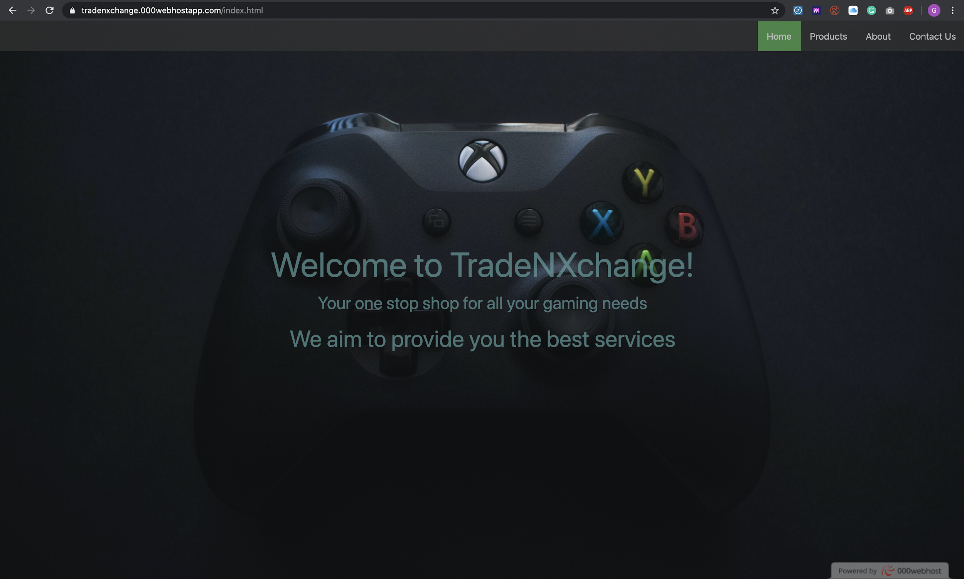
Our Frontend idea(still under execution)

Slide 8
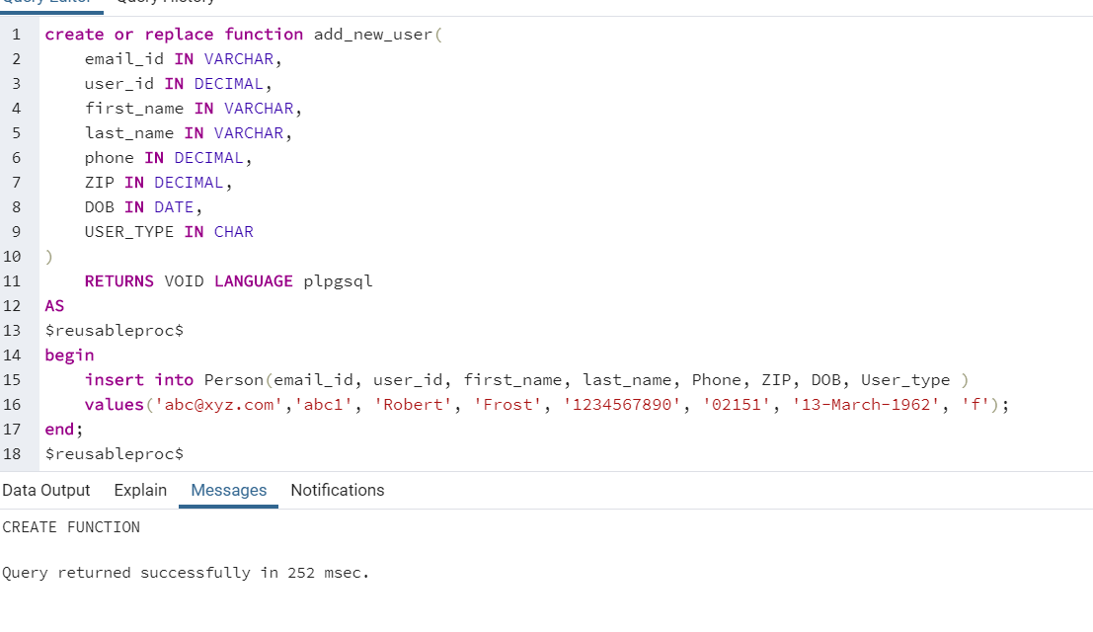
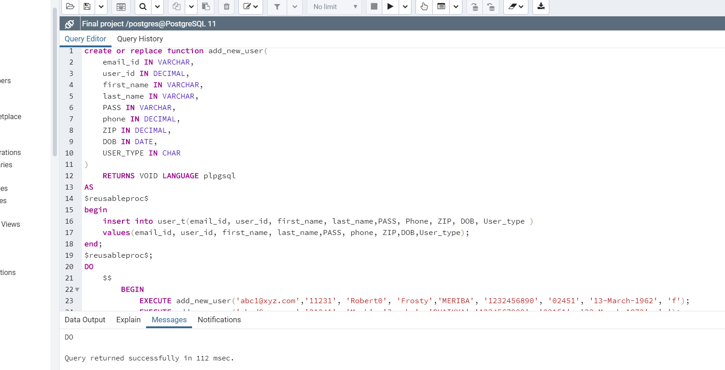
Some screenshots

Slide 9
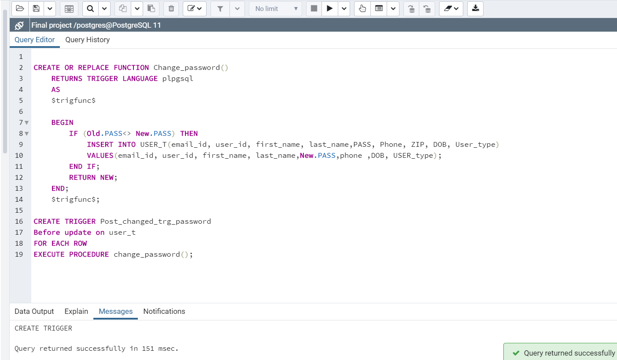
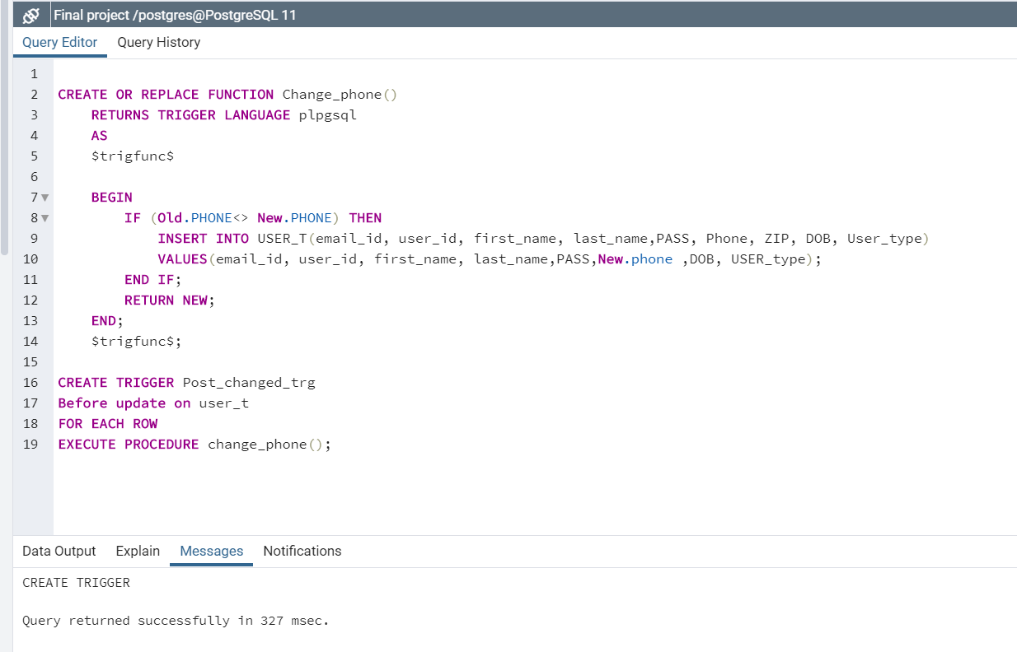
continued...

Slide 10
Scope of Improvement
Including Payment Gateway
Ratings and Reviews
Including logistics/logistics partner

Slide 11
Conclusion
Had to made a lot of changes to business model.
Whatever we think about and applying them technically are 2 different things.
Do it more efficiently.
This project made our understanding better about how business logic and technical rules work.

